Slide 1
Azure News
Talk: What's up in Azure 2020

Slide 2



WELCOME!
MARTIN BRANDL
Cloud Solution Architect, Head of Cloud Development and Operations
white duck
@martin_jib
https://www.linkedin.com/in/mbrandl/
https://about-azure.com/

Slide 3
2019 Announcements
01
02
DEMO 2
TABLE OF CONTENTS
04
03
HOW TO STAY UP TO DATE
05
SNEAK PEEK
06
DEMO 1
**** (SECRET)
What we are waiting for in 2020
**** (SECRET)
Here you could describe the topic of the section
Here you could describe the topic of the section

Slide 4
2019
ANNOUNCEMENTS
The most important announcements about Azure for Developers in 2019

Slide 5
Azure PowerShell Cross-platform “Az” module
18.12.2018 (Source)
Replacement for AzureRM
Runs on PowerShell 5.1 and PowerShell Core
All cmdlets use "Az" as their noun prefix
Note: You should not install Az side-by-side with AzureRM
Notes:
Az is a replacement for AzureRM and AzureRM.Netcore.
Az runs on PowerShell 5.1 and PowerShell Core.
You should not install Az side-by-side with AzureRM. Remove all AzureRM modules before installing Az.

Slide 6
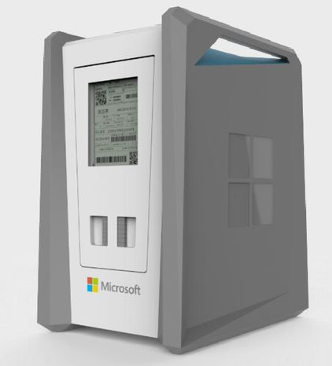
General availability: Azure Data Box Disk
09.01.2019 (Source)

Slide 7

General availability: Azure Lab Services
27.02.2019 (Source)

Slide 8

General availability: Azure Function, Java Support
27.02.2019 (Source)

Slide 9

General availability: New Event Grid features
19.02.2019 (Source)
Retry policies
Dead lettering
Storage queues as a destination
Hybrid connections as a destination
Manual validation handshake

Slide 10

General availability: Azure Automation supports the Azure PowerShell Az module
11.02.2019 (Source)

Slide 11

Azure Resource Manager template language additions
11.03.2019 (Source)
output now support the condition property
newGuid()
utcNow()

Slide 12

General availability: Azure premium blob storage
19.03.2019 (Source)

Slide 13

General availability: Azure Front Door Service
27.04.2019 (Source)

Slide 14
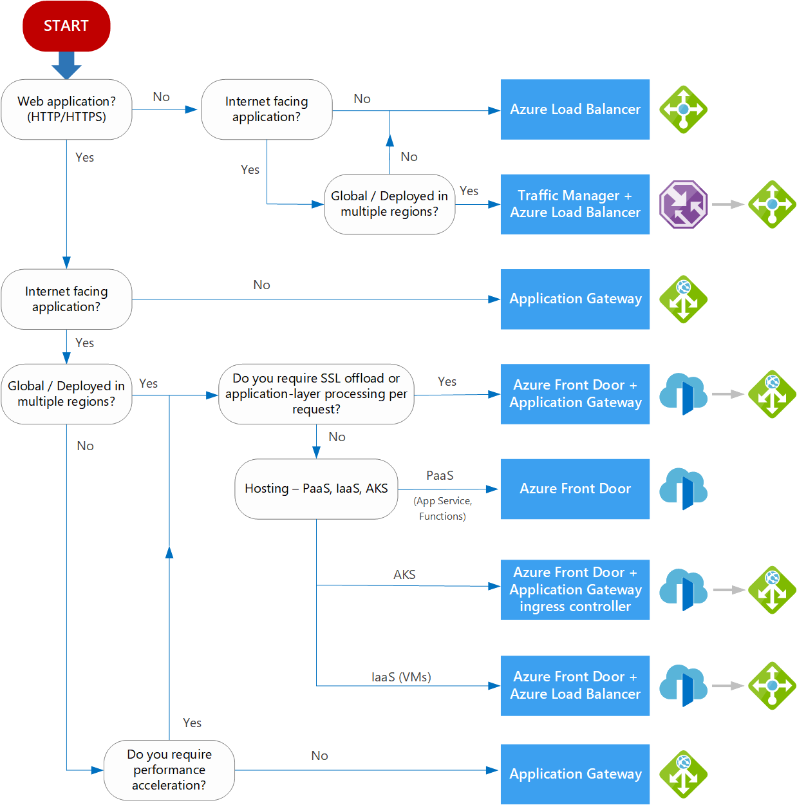
Decision tree for load balancing in Azure

Slide 15
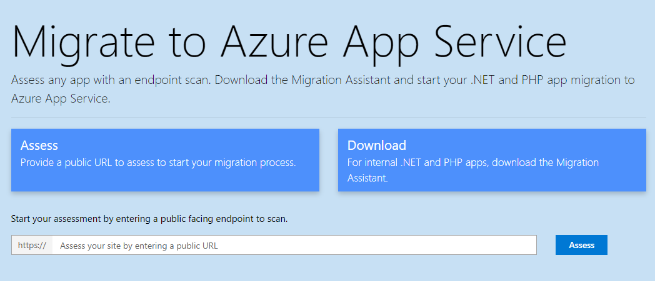
General availability: App Service Migration Assistant for ASP.NET applications
10.04.2019 (Source)

Slide 16
General availability: Advanced filtering in EventGrid
29.03.2019 (Source)
Route messages with no restriction on the number of nested objects in your JSON
E. G. data.key1.key2....keyN

Slide 17
General availability: Azure Dev Spaces
14.03.2019 (Source)
Run your service in a live AKS cluster and test it end-to-end

Slide 18

General availability: Azure Red Hat OpenShift
08.05.2019 (Source)

Slide 19
General availability: Microsoft Authentication Library for Javascript
03.05.2019 (Source)

Slide 20

Azure now supports GitHub identity single sign-on
06.05.2019 (Source)

Slide 21

General availability: User-defined network policy in Azure Kubernetes Service (AKS)
06.05.2019 (Source)

Slide 22
General availability: Azure Kubernetes Service (AKS) virtual node
06.05.2019 (Source)

Slide 23

General availability: Azure Container Registry content trust
06.05.2019 (Source)

Slide 24
General availability: Azure Container Registry tag locking policy
06.05.2019 (Source)

Slide 25

General availability: Azure Resource Graph
15.07.2019 (Source)

Slide 26
Introducing the Microsoft Cloud Adoption Framework for Azure
15.07.2019 (Source)

Slide 27

General availability: Azure Function Consumption plan for Linux
21.08.2019 (Source)

Slide 28

General availability: Python support in Azure Functions
21.08.2019 (Source)

Slide 29
General availability: User-assigned managed identities for App Service and Azure Functions
19.08.2019 (Source)
Azure AD
User Principal
Service Principal
App
Registration
Managed
Identities
User
Assigned
System
Assigned

Slide 30

General availability: Custom OpenID identity providers in Azure AD B2C
15.08.2019 (Source)

Slide 31

General availability: Microsoft Azure Ultra Disks
15.08.2019 (Source)

Slide 32
General availability: Egress lockdown Azure Kubernetes Service
18.09.2019 (Source)

Slide 33

Microsoft Azure available from new cloud regions in Germany
10.09.2019 (Source)
Germany West Central (Frankfurt)
Germany North (Berlin)

Slide 34

General availability: Key Vault references in App Service and Azure Functions
15.10.2019 (Source)
@Microsoft.KeyVault(SecretUri=https://myvault.vault.azure.net/ secrets/mysecret/ec96f02080254f109c51a1f14cdb1931)

Slide 35
General availability: Standard Load Balancers in Azure Kubernetes Service
02.10.2019 (Source)

Slide 36
General availability: GitHub Actions for Azure
13.11.2019 (Source)

Slide 37

General availability: Azure Private Link
05.11.2019 (Source)

Slide 38
General availability: Azure Kubernetes Service cluster autoscaler
04.11.2019 (Source)

Slide 39
General availability: Azure Container Registry OCI artifact support
04.11.2019 (Source)

Slide 40

General availability: Azure Data Share
11.11.2019 (Source)

Slide 41
General availability: Azure Kubernetes Service support for multiple node pools
04.11.2019 (Source)

Slide 42
General availability: Azure Kubernetes Service support for Availability Zones
04.11.2019 (Source)

Slide 43

General availability: Azure Bastion
04.11.2019 (Source)

Slide 44

General availability: Azure Functions PowerShell support
04.11.2019 (Source)

Slide 45
General availability: GitHub Actions for Azure Pipelines
06.12.2019 (Source)

Slide 46
Azure AD B2C is deprecating login.microsoftonline.com
06.12.2019 (Source)
On December 4th, 2020
move onto B2Clogin.com

Slide 47
2020
ANNOUNCEMENTS
(… we are waiting for)

Slide 48
General availability: Azure Functions runtime 3.0
23.01.2020 (Source)

Slide 49
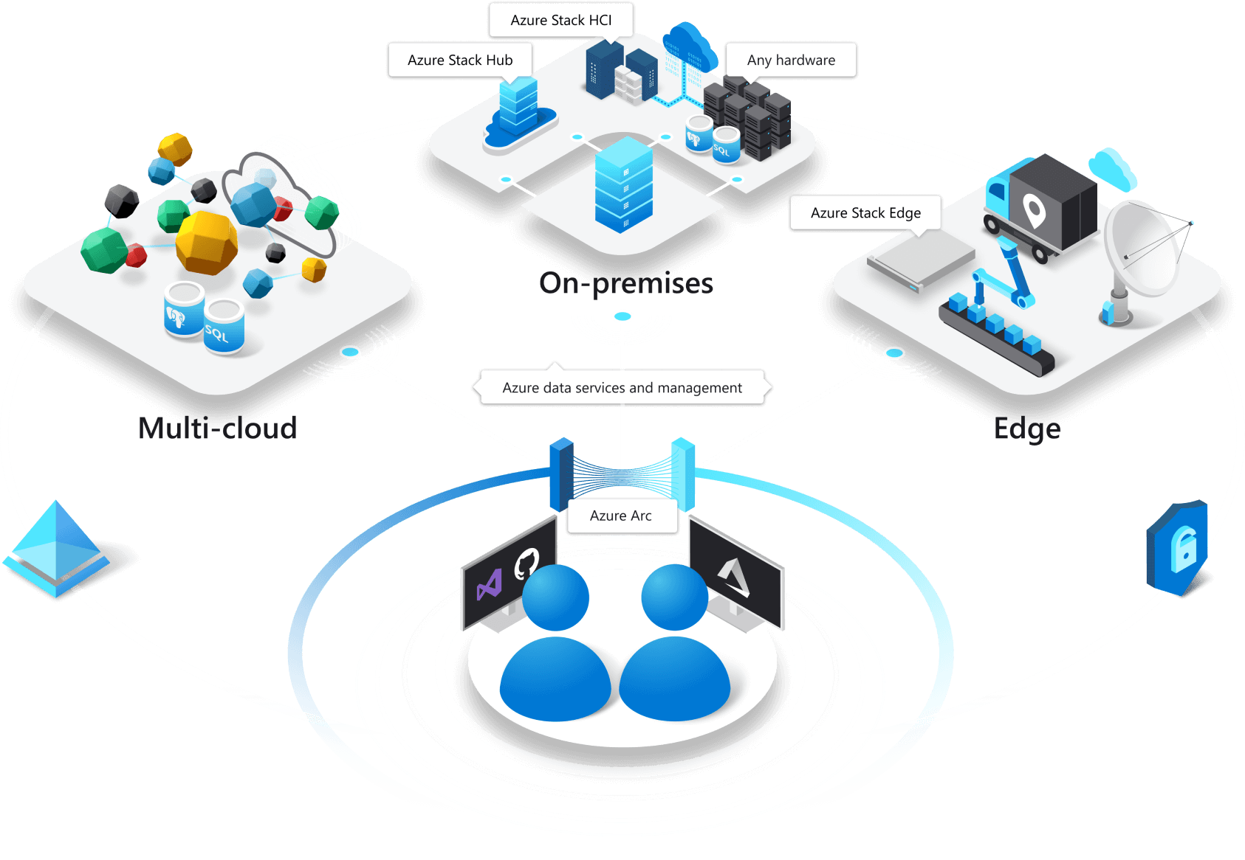
Azure Arc

Slide 50
Azure Kubernetes Service Windows Container support

Slide 51

Application Insights in Germany West Central
Expect April, 2020

Slide 52

dapr (Distributed Application Runtime)
Expect Q1, 2020

Slide 53
HOW TO
STAY UP TO DATE
…with Azure

Slide 54
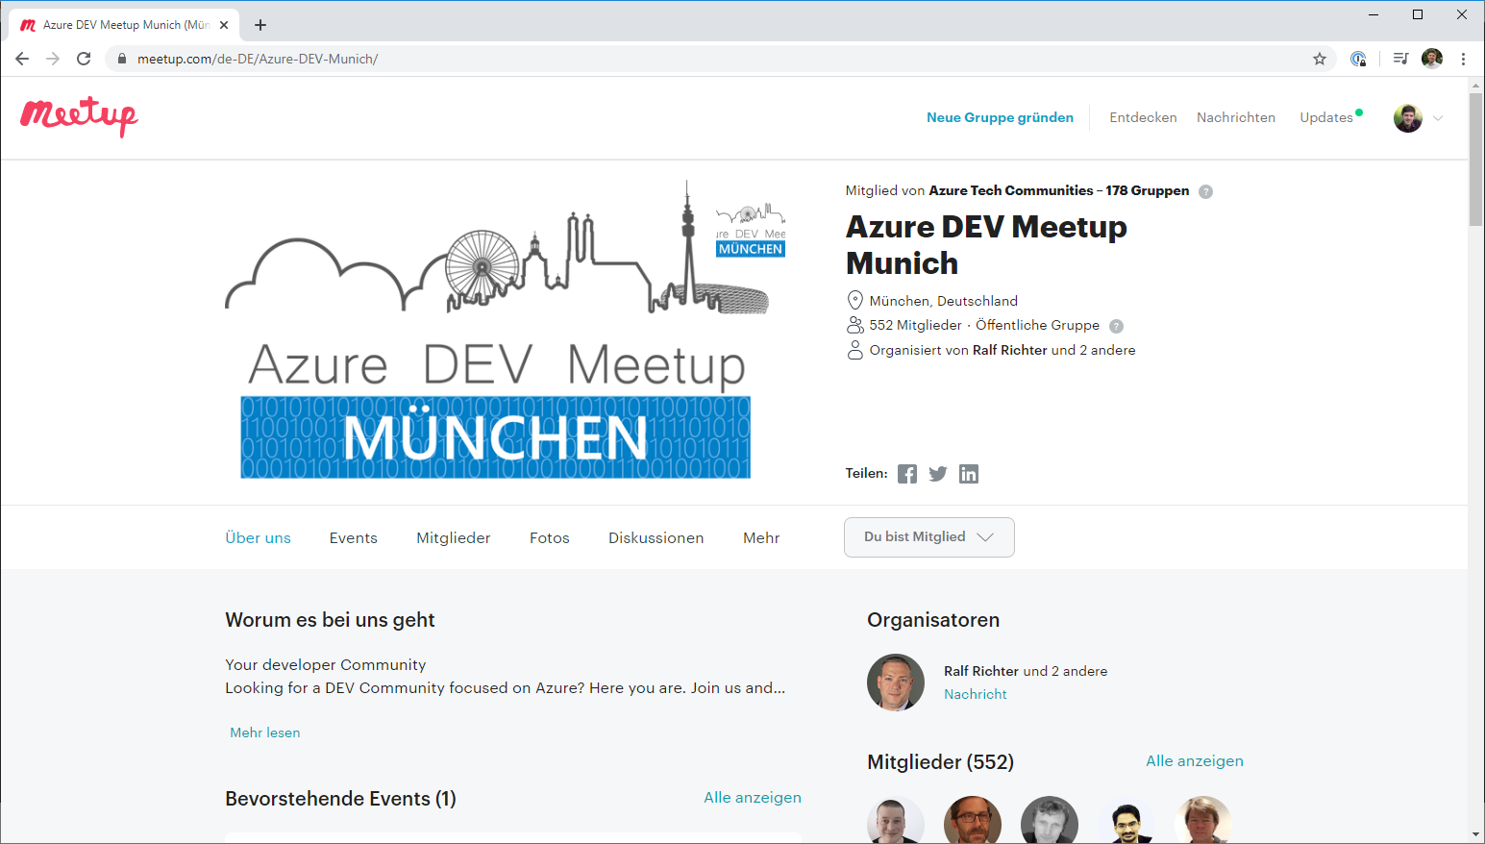
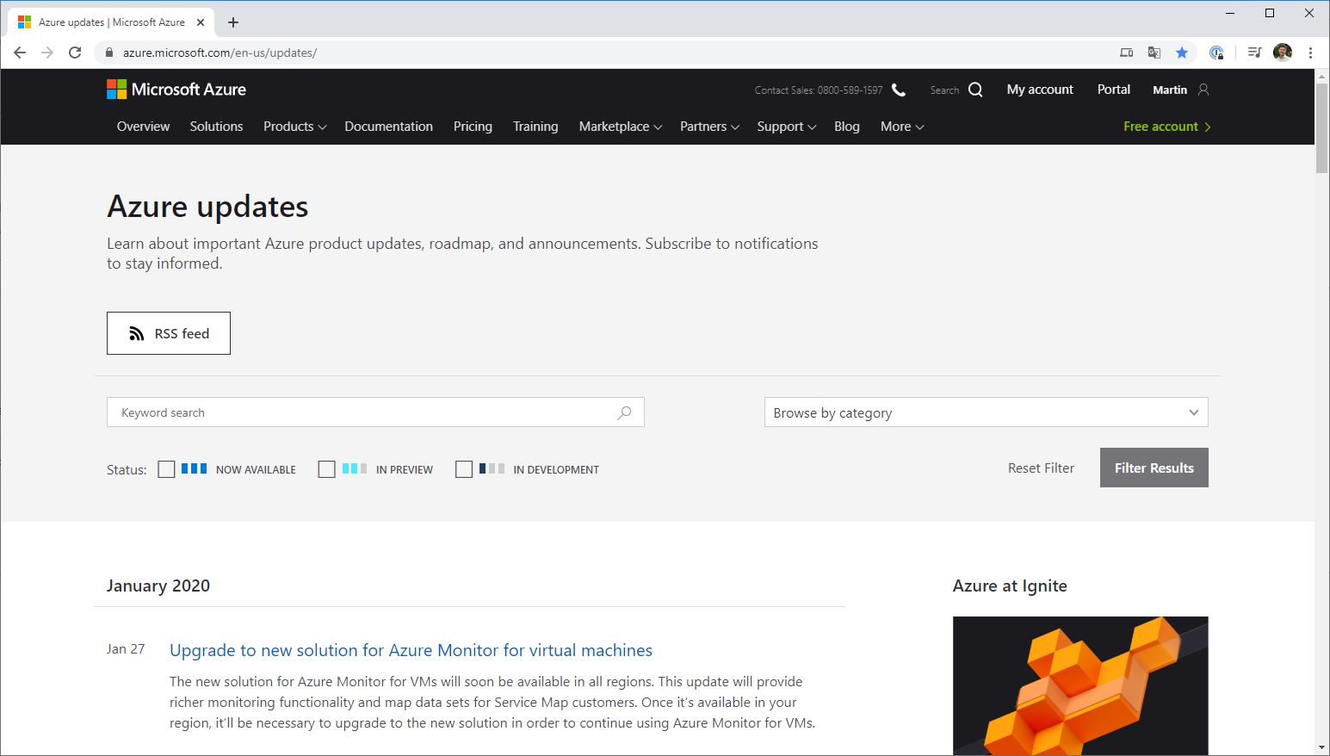
Events
Azure Meetups
Meetups zu Microsoft Azure in Deutschland
Azure DEV Meetup München
Azure Rosenheim Meetup

Slide 55
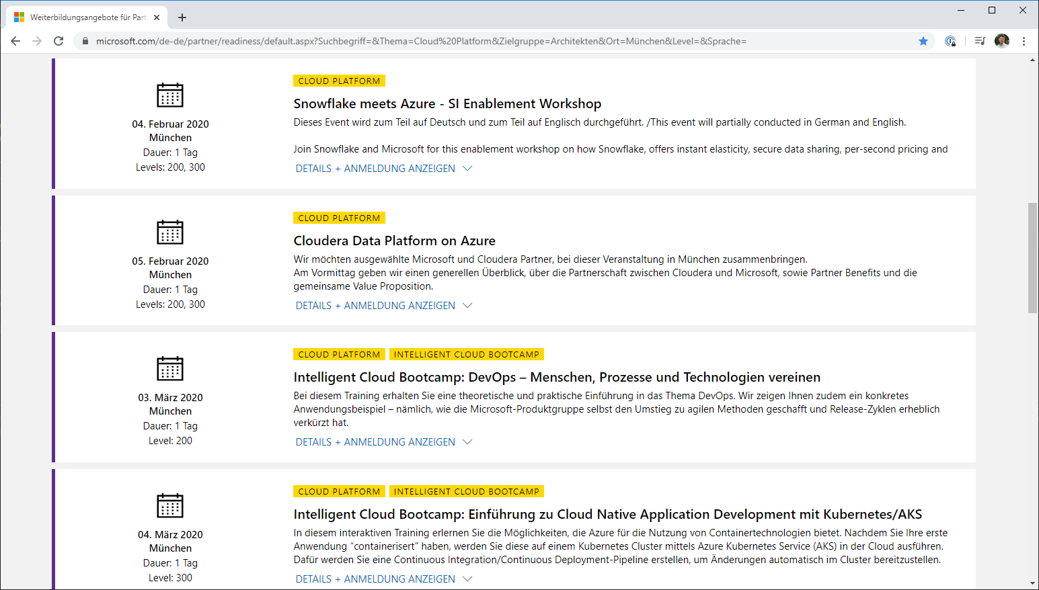
Events
Advanced trainings for partners
upcomming events

Slide 56
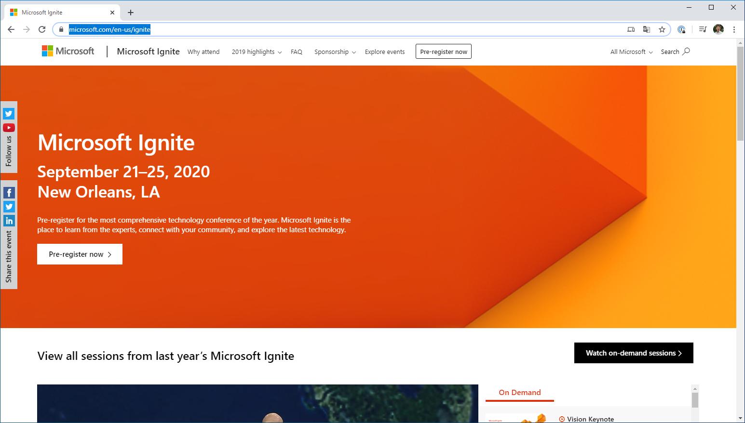
Events
Microsoft Ignite
Azure Weekly is a summary of the week's top news to help you build on the Microsoft Azure Platform.

Slide 57
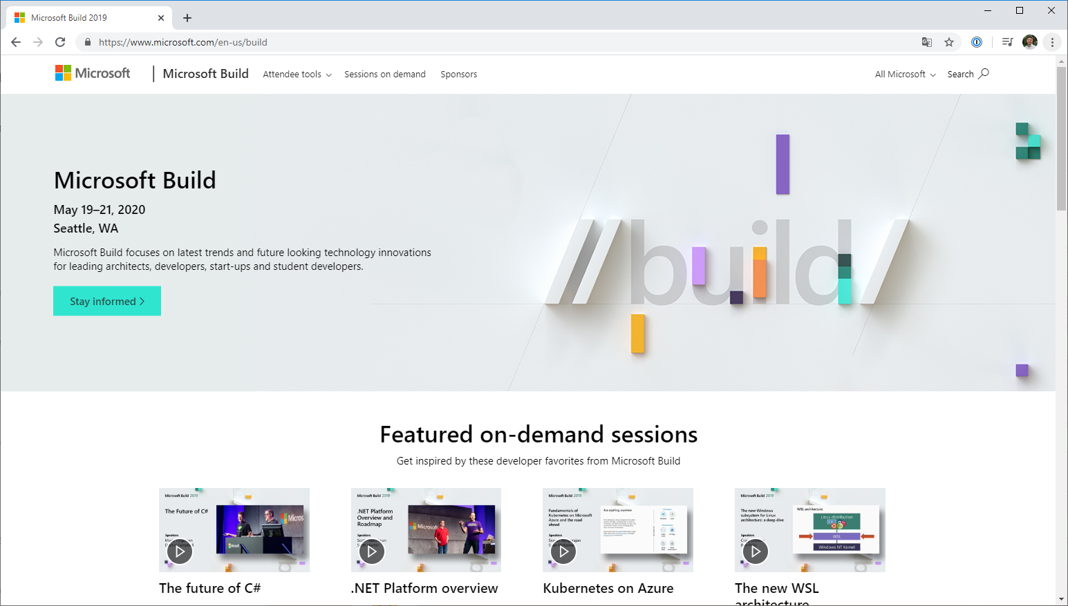
Events
Microsoft Build
Azure Weekly is a summary of the week's top news to help you build on the Microsoft Azure Platform.

Slide 58
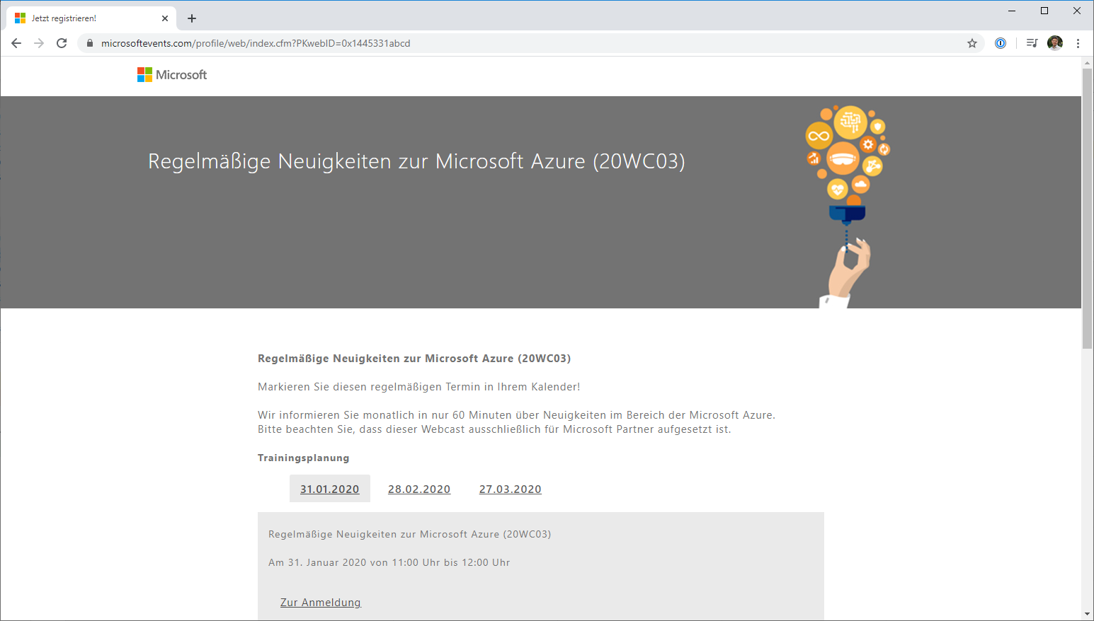
Events
Regelmäßige Neuigkeiten zur Microsoft Azure (20WC03)
Azure Weekly is a summary of the week's top news to help you build on the Microsoft Azure Platform.

Slide 59
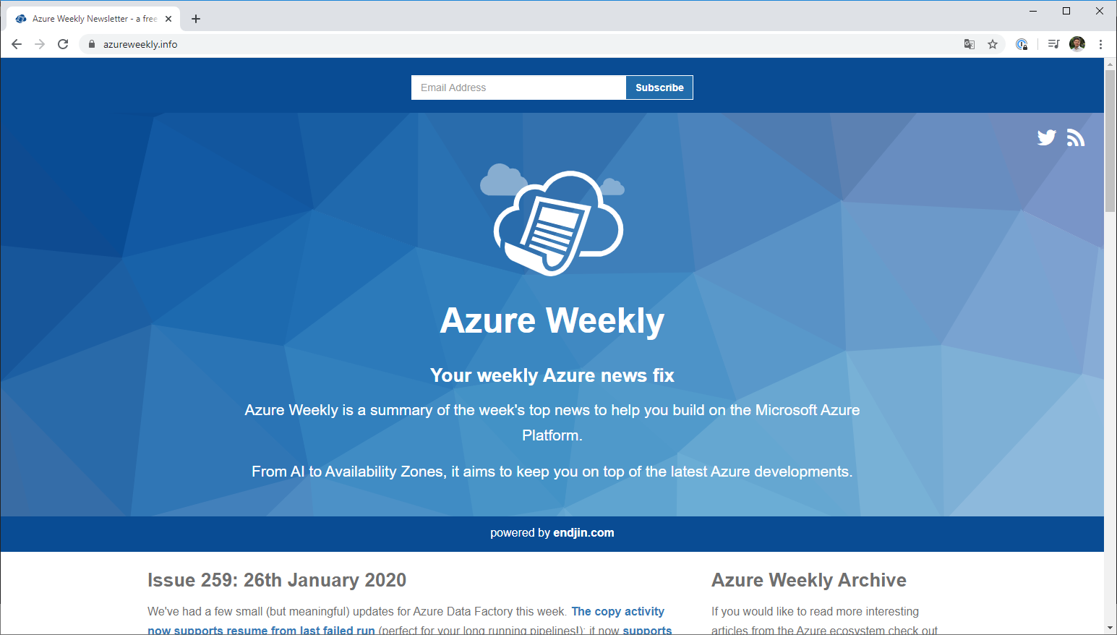
SITES
Azure Weekly
Azure Weekly is a summary of the week's top news to help you build on the Microsoft Azure Platform.

Slide 60

SITES
Azure updates
Azure Weekly is a summary of the week's top news to help you build on the Microsoft Azure Platform.

Slide 61
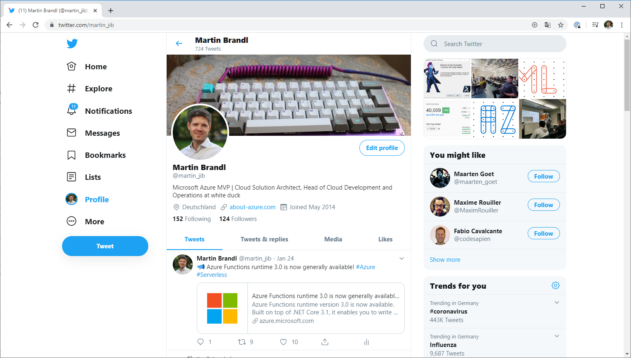
Twitter
Who should I follow?
@markrussinovich
@MSCloud
@Microsoft
@AzureWeekly
@msdev
@MSFTnews
@Build5Nines
---------
@jeffhollan
@brendandburns

Slide 62
THANKS
Does anyone have any questions?

